Slide 1
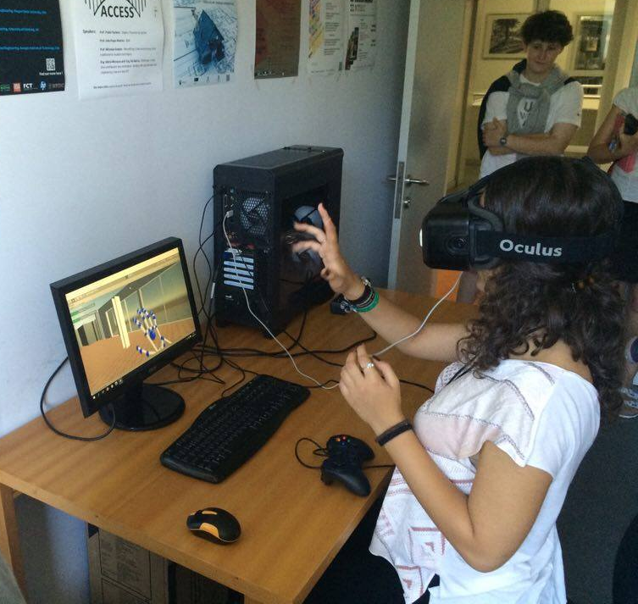
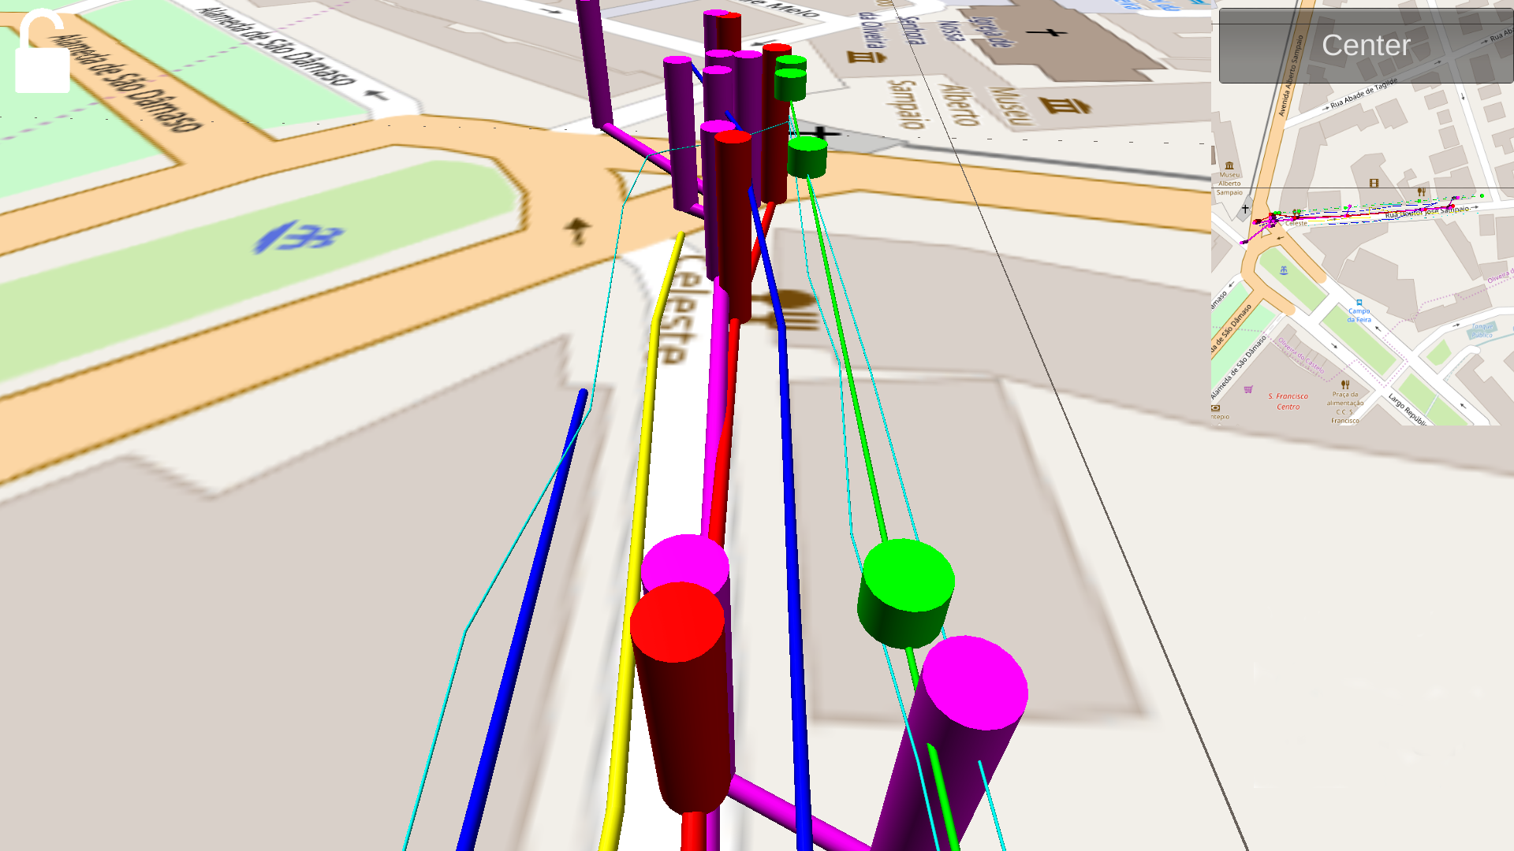
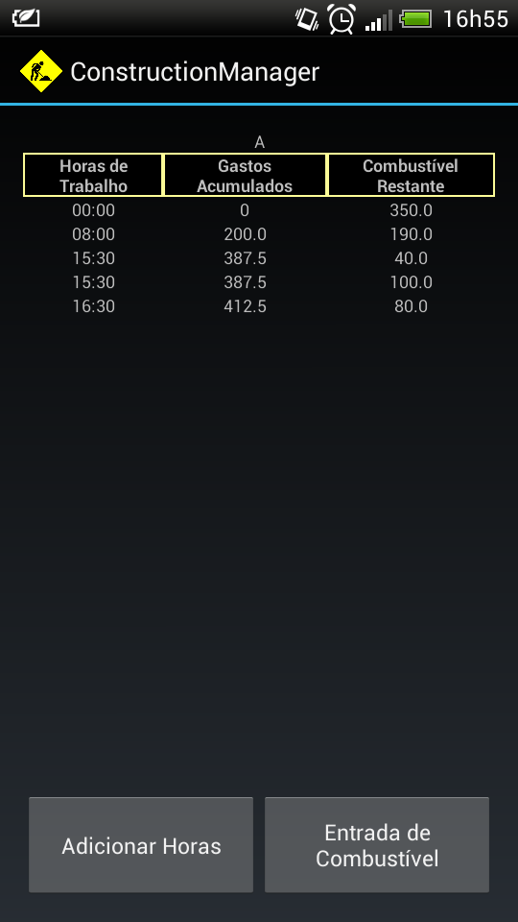
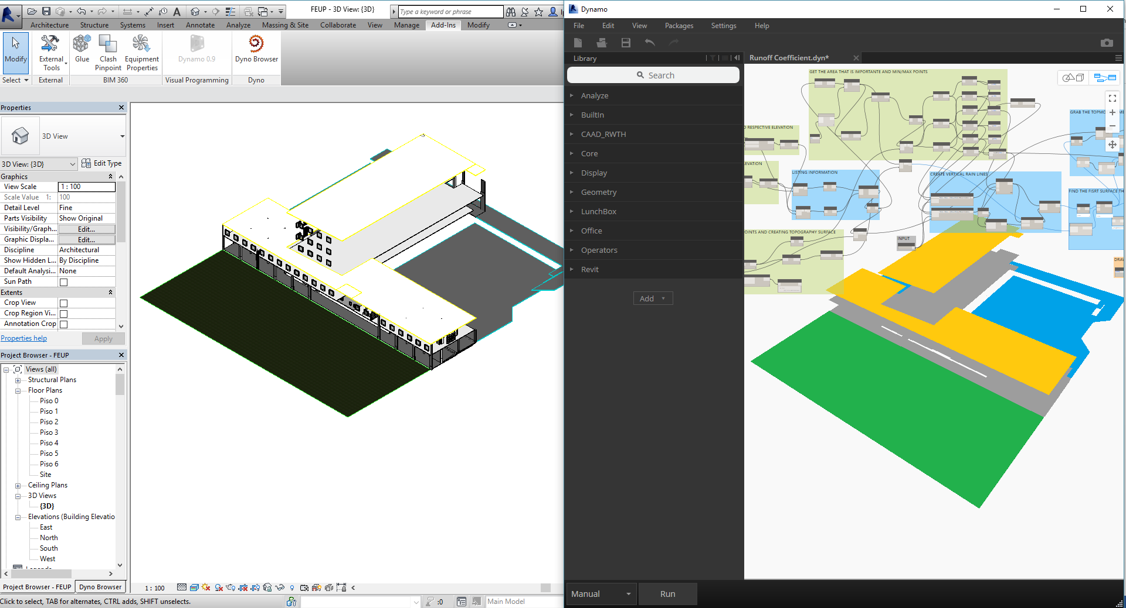
Department of Civil Engineering - Building Division
Management and Technology
of Building Construction
Building Information Modelling (BIM)
OBJECTIVES
Development and assessment of new forms of interaction with BIM models and applications, in particular through the use of Natural User Interfaces (NUI) and Virtual Reality (VR)
Development of BIM-based automated code checking systems
MAIN OUTCOMES
Development of mobile applications for on-site construction inspection
Development of Virtual Reality Natural User Interfaces and assessment of their usability
Development of software tools for the automation of Rainwater Runoff LEED credits
Assessment of BIM adoption in Portugal (including survey with about 400 replies from construction professionals)
Assessment of usability of different VR interface methods
Gesture-based interaction with BIM modelling applications – tests performed with participants from different age and professional groups
BIM adoption survey
Mobile application for infrastructure inspection
Mobile Construction Management application
Tools for the automation of Rainwater Runoff LEED credits
R&D PROJECTS (STARTING IN 2016)
“SUDOE Stations of Transport OPposed to CO2”: SOE1/P3/E0032, FEDER – Interreg SUDOE
Total EU Grant: €865.555 (2016-2019)
Energy assessment in transport buildings; Reality Capture using Laser Scanning; BIM to support energy assessment
“Educational Lab – Big Machine”: 2016-1-PT01-KA201-022986, Erasmus+
Total grant: €158.010; FEUP, Project Leader: €66.545 (2016-2018)
Development of Outreach Activities; Development of scaled physical models; Development of online educational content accessible through QR codes; Development of immersive VR models; Development of BIM models
This work was financially supported by: Project POCI-01-0145-FEDER-007457 - CONSTRUCT - Institute of R&D In Structures and Construction funded by FEDER funds through COMPETE2020 - Programa Operacional Competitividade e Internacionalização (POCI) – and by national funds through FCT - Fundação para a Ciência e a Tecnologia;
FEUP – Faculty of Engineering - University of Porto
Rua Dr. Roberto Frias, Edf.G,4200-465 Porto
Tel.: +351 225 081 940 e-mail: jppm@fe.up.pt

